Slide 1
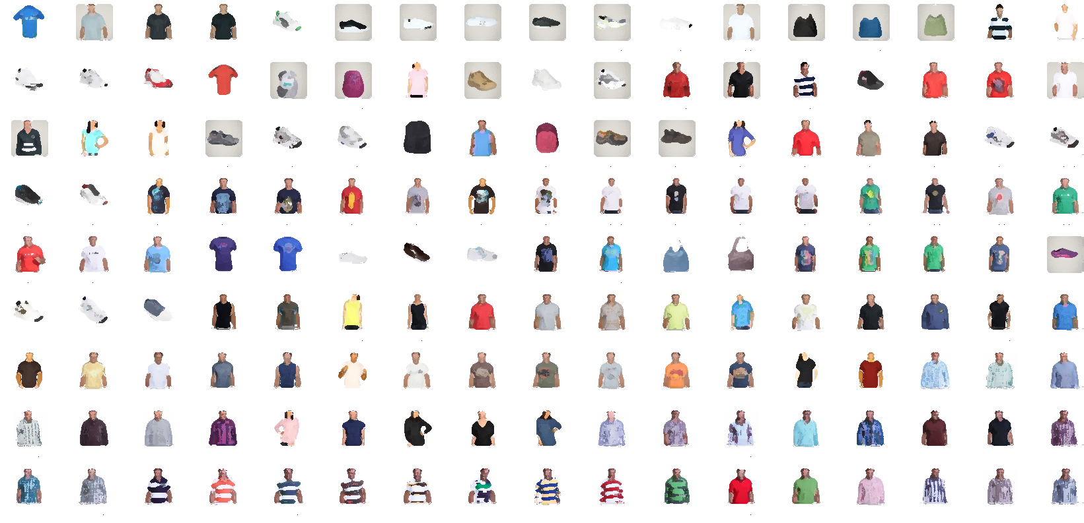
Fashion product classification
&
Recommender system

Slide 2
The data contained more then 22000 fashion product images
Data was spited into training (17 k ) and validation data set
Validation data set was completed balanced.
Two CNN model was trained to classify an product image into category and gender.
Embedded layer output was taken to recommended similar products.

Slide 3
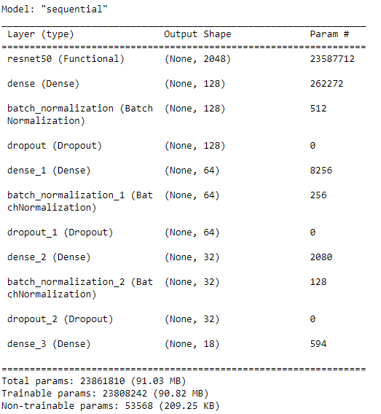
MODEL 1 :
CLASSIFY INPUT INTO CATEGORY

Slide 4
Architecture
RASNET - 50
LAYER 1
LAYER 2
LAYER 3
Category prediction
This model is used to classify an product image category ( t-shirt , shirt , salwar , watch , bag pack , wallet etc. )
It was trained on more then 17000 product images.
ACCURACY : 92 %

Slide 5
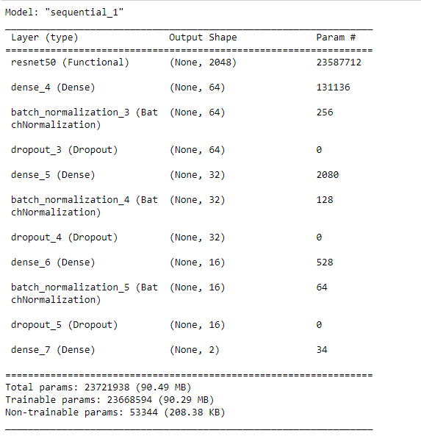
MODEL 2 :
CLASSIFY INPUT INTO GENDER

Slide 6
Architecture
RASNET - 50
LAYER 1
LAYER 2
LAYER 3
Category prediction
This model is used to classify an product image gender ( Male , Female )
It was trained on more then 17000 product images.
ACCURACY : 93.13 %

Slide 7
Procedure :
INPUT IMAGE
Gender classification
Category classification
Select images belonging to predicted categories from both classification
Use embedding layer output & use cosine similarity to select most similar images
Recommendation

Slide 8
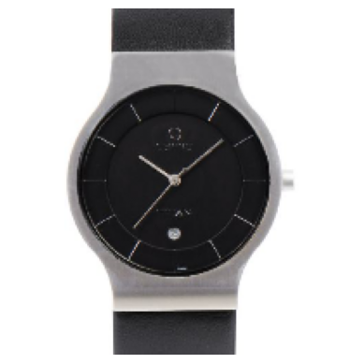
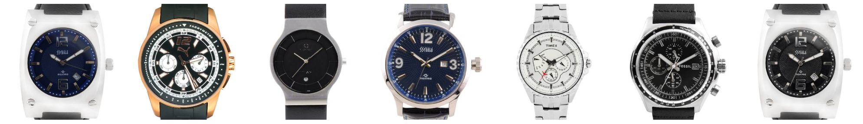
Result :
INPUT
RECCOMEDATION

Slide 9
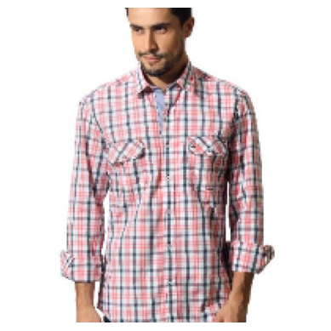
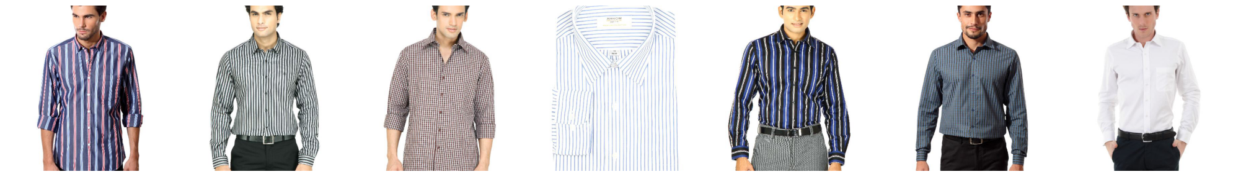
INPUT
RECCOMEDATION

Slide 10
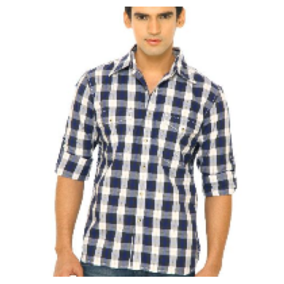
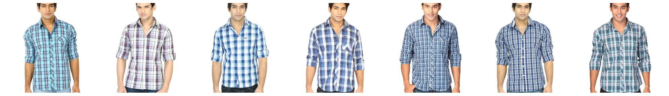
INPUT
RECCOMEDATION

Slide 11
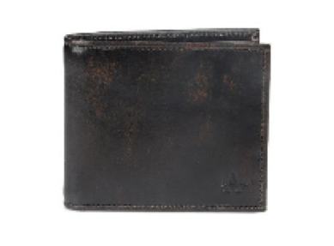
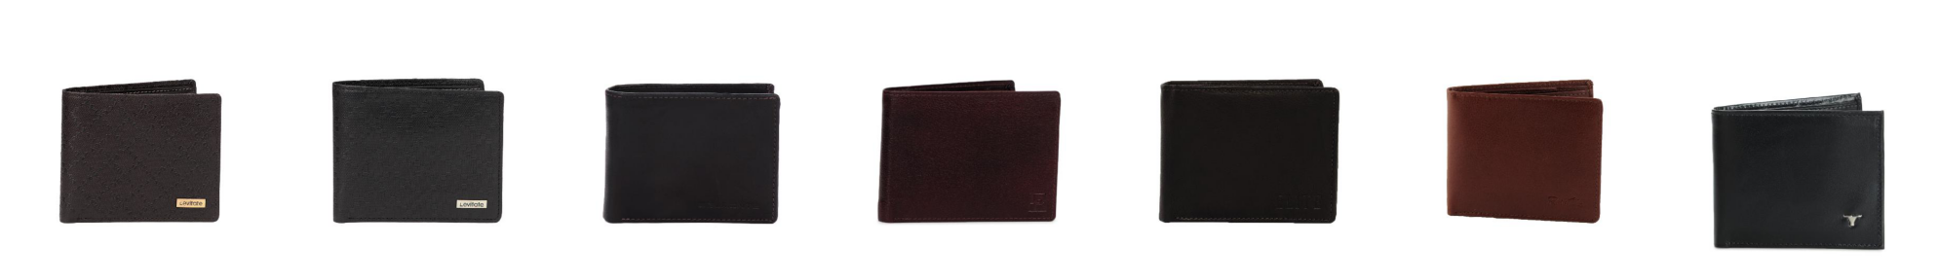
INPUT
RECCOMEDATION

Slide 12
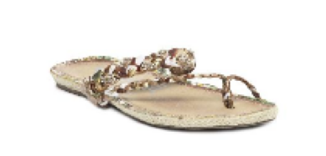
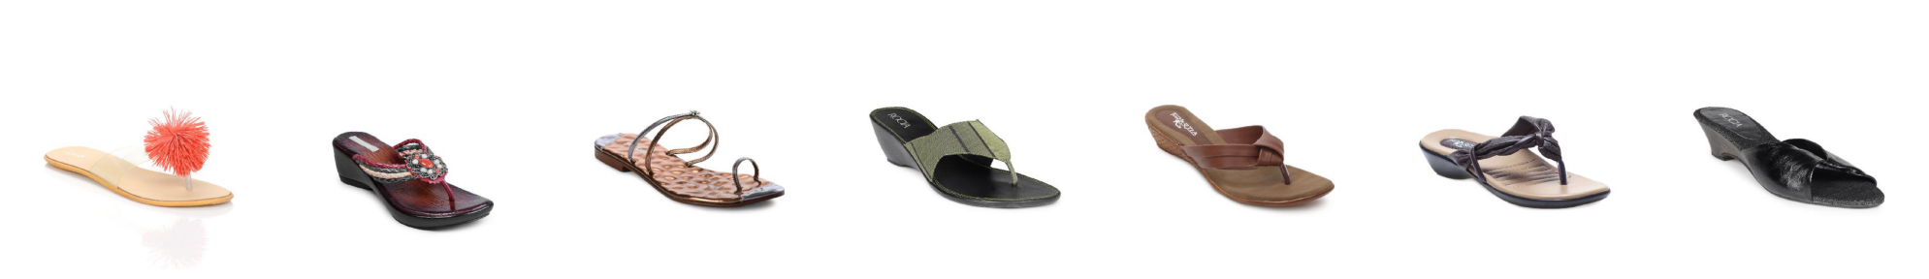
INPUT
RECCOMEDATION

Slide 13
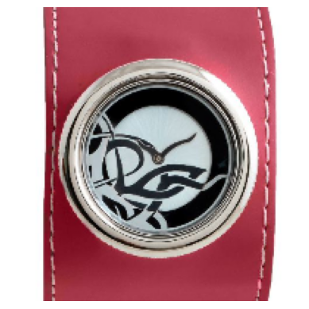
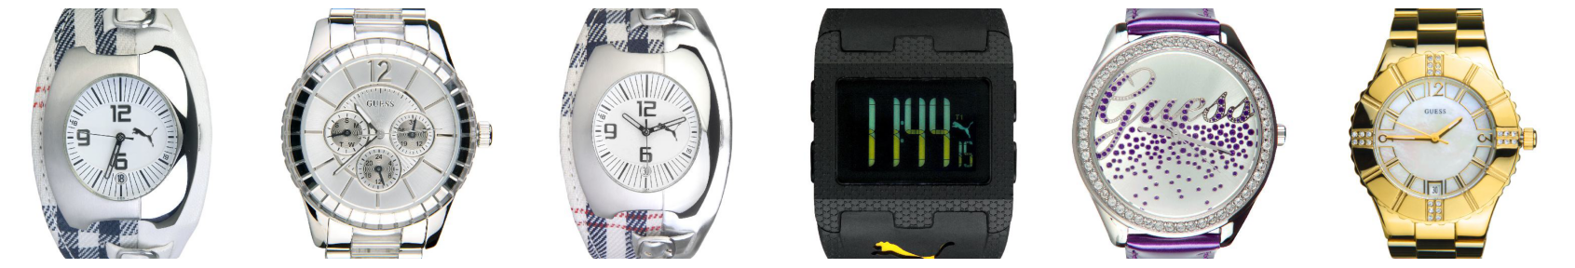
INPUT
RECCOMEDATION

Slide 14
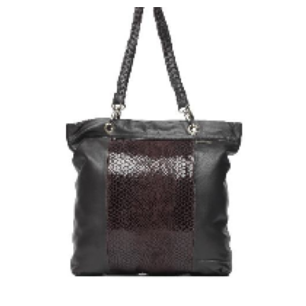
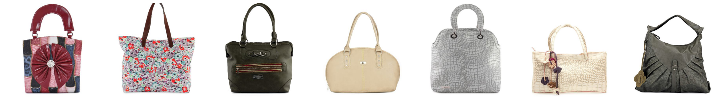
INPUT
RECCOMEDATION

Slide 15
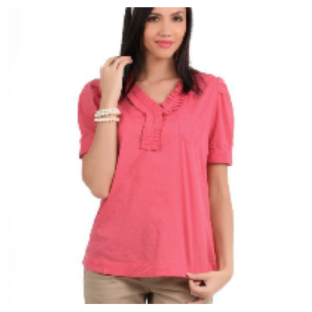
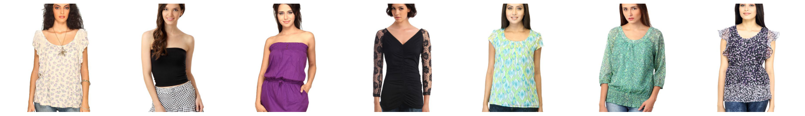
INPUT
RECCOMEDATION

